Slide 1
Probabilistic Methods
By: Ashok Basnet

Slide 2
Course Outline
Introduction to Probabilistic Reasoning
Bayes Network
Markov Network
DBN’s and HMN’s

Slide 3
Introduction to Probabilistic Reasoning
Agents may need to handle uncertainty, whether due to partial observability, nondeterminism, or a combination of the two.
An agent may never know for certain what state it's in or where it will end up after a sequence of actions.
Agent can cope with these defects and make rational judgments and rational decisions to handle such uncertainty and draw valid conclusions.
Probability provides a way of summarizing the uncertainty that comes from our laziness and ignorance (both theoretical and practical), thereby solving the quantification problem.

Slide 4
Introduction to Probabilistic Reasoning
What is uncertainty?
The lack of the exact knowledge that would enable us to reach a perfectly reliable conclusion
Classical logic permits only exact reasoning i.e. perfect knowledge always exists
If A is true THEN A is not false and If B is true THEN B is not false.
In real world such clear cut knowledge could not be provided to systems.

Slide 5
Introduction to Probabilistic Reasoning
Sources of Uncertain Knowledge
Weak Implication: Domain experts and knowledge engineer have rather painful or hopeless task of establishing concrete correlation between IF(Condition) and THEN(action) part of rules. Vague Data.
Imprecise Language: NLP is ambiguous and imprecise. We define facts in terms of often, sometimes, frequently, hardly ever. Such can affect IF-THEN implication
Unknown Data: incomplete and missing data should be processes to an approx. reasoning with this values
Combining the views of different experts: Large system uses data from many experts

Slide 6
Introduction to Probabilistic Reasoning
Probabilistic reasoning provides a mathematical framework for representing and manipulating uncertainty.
Unlike deterministic systems, which operate under the assumption of complete and exact information, probabilistic systems acknowledge that the real world is fraught with uncertainties.
Probabilistic reasoning is one of the most important methods to empower AI applications and is widely used, dealing with the uncertainty of the problem to make logical decisions.

Slide 7
Introduction to Probabilistic Reasoning
Key Concepts:
Bayesian Networks
Markov Model
Hidden Marko Models
Probabilistic Graphical Models

Slide 8
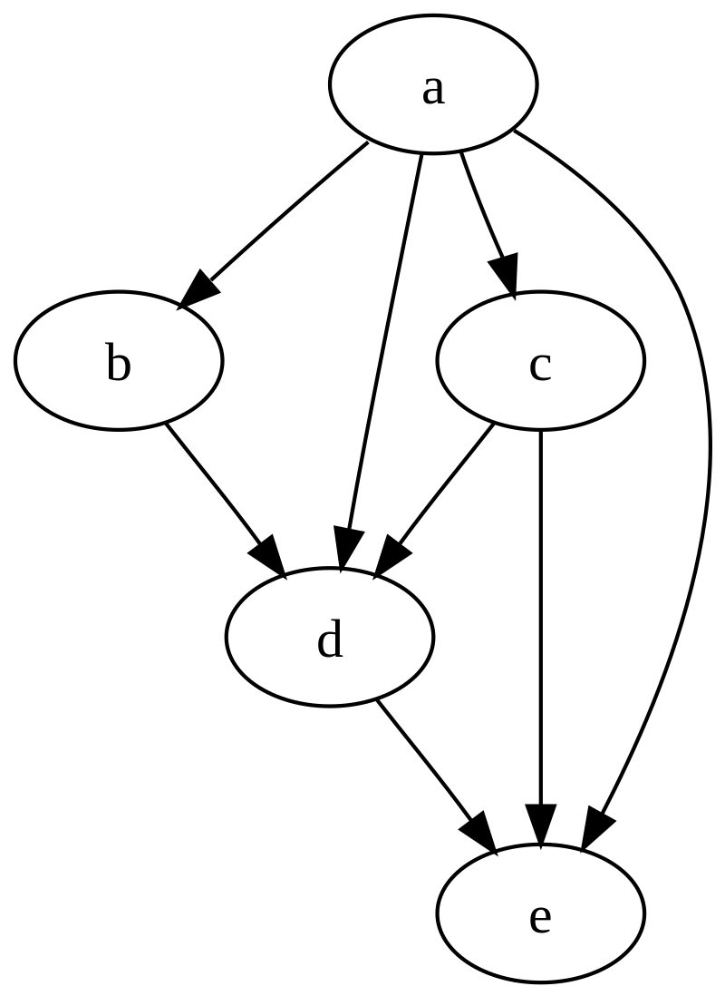
Bayesian Network
Bayesian Network is a data structure to represent the dependencies among variables.
Bayesian Network is also known as Belief Network, Probabilistic Network, Causal Network, and Knowledge Map.
A Bayesian Network is a directed graph in which each node is annotated with quantitative probability information.

Slide 9
Bayesian Network
The full specification follows:
Each node corresponds to a random variable, which may be discrete or continuous.
A set of directed links or arrows connects pairs of nodes. If there is an arrow from node X to node Y, X is said to be a parent of Y. The graph has no directed cycles (and hence is a directed acyclic graph, or DAG)
Each node X_{i} has a conditional probability distribution P(X_{i} | Parents(X_{i})) that quantifies the effect of the parents on the node.

Slide 10
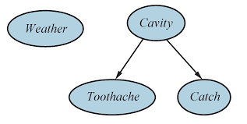
Bayesian Network
A BN is a directed graph with the following properties (contd…)
If an arc is drawn from Y to Z, then Y is a parent or immediate predecessor of Z, and Z is a descendant of Y
Each variable is conditionally independent of its non-descendants in the graph, given its parents.
Z

Slide 11
Bayesian Network
Incremental Network Construction:
Nodes: First determine the set of variables that are required to model the domain. Now order them, { X₁, X₂, ….. ,X_{n} }. Any order will work, but the resulting network will be more compact if the variables are ordered such that causes precede effects.
Links: for i = 1 to n do:
- Choose, from { X₁, X₂, ….. ,X_{n-1} }, a minimal set of parents for X_{i} such that equation P(X_{i} | X_{i-1}, …., X₁) = P(X_{i} | Parents(X_{i})) is satisfied.
- For each parent insert a link from the parent to X_{i}
- Write down the conditional probability table, P(X_{i} | Parents(X_{i}))

Slide 12
Example: Bayesian Network
Consider the given example: You have a new burglar alarm installed at home. It is fairly reliable at detecting a burglary, but also responds on occasion to minor earthquakes.
You also have two neighbors, John and Mary, who have promised to call you at work when they hear the alarm. John nearly always calls when he hears the alarm, but sometimes confuses the telephone ringing with the alarm and calls then, too. Mary, on the other hand, likes rather loud music and often misses the alarm altogether.
Given the evidence of who has or has not called, we would like to estimate the probability of a burglary.

Slide 13
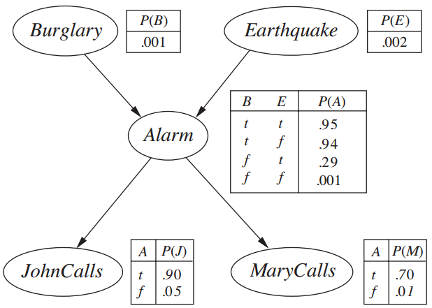
Bayesian Network

Slide 14
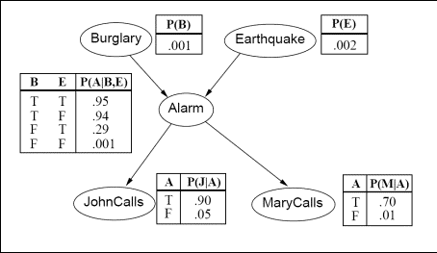
Can also be represented as

Slide 15
Question: Bayesian Network
Q1. What is the probability that the alarm has sounded but neither a burglary nor an earthquake has occurred, and both John and Marry call?
Q2. What is the probability that John call ?
Q3. What is the probability that john calls given the Burglary ?

Slide 16
Question: Bayesian Network
Q1. What is the probability that the alarm has sounded but neither a burglary nor an earthquake has occurred, and both John and Marry call?
P(john_call ^ mary_call ^ alarm ^ ¬burglary ^ ¬earthquake) = P(john_call | alarm) P(mary_call | alarm) P(alarm | ¬burglary, ¬earthquake) P(¬burglary) P(¬earthquake)
= 0.9 * 0.7 * 0.001 * 0.999 * 0.998
= 0.00062

Slide 17
Question: Bayesian Network
Q2. What is the probability that John call ?
P(j) = P(j | a) P(a) + P(j | ¬ a) P(¬a)
= P(j | a) {P(a | b, e) P(b,e)+ P(a | ¬b,e) P(¬b,e) + P(a | b, ¬e) P(b,¬e) + P(a | ¬b, ¬e)P(¬b,¬e) } + P(j | ¬a) {P(¬a | b, e) P(b,e)+ P(¬a | ¬b,e) P(¬b,e) + P(¬a | b, ¬e) P(b,¬e) + P(¬a | ¬b, ¬e)P(¬b,¬e) }
= 0.90 * 0.00252 + 0.05 * 0.9974 = 0.0521

Slide 18
Bayesian Belief Network
It can readily handle incomplete data sets
It allows one to learn about causal relationships
It readily facilitate use of prior knowledge
It Provide a natural representation for conditional independence
It is more complex to construct the graph

Slide 19
Markov Network
The canonical probabilistic model of temporal or sequential data is called Markov Model or Markov Network
“Future is independent of the past given the present”
They model a process that proceeds in steps (time, sequence, trials, etc.); like a series of probability trees
E.g. What is the World at the end of this …………….. ?

Slide 20
Question: Bayesian Network
Q3. What is the probability that john calls given the Burglary ?
P(j | b) = P(a|b) * P(j) + P( ¬(a|b) * P(¬j) ------------------- (1)
First calculate probability of alarm ringing on burglary:
P(a|b) = P(b)P(¬e)P(B ∩ ¬E) + P(B)P(E)P(B ∩ E)
P(a|b) = 1 * 0.998 8 0.94 + 1 * 0.002 * 0.95
P(a|b) = 0.94
Putting value on equation (1)
P(j | b) = 0.94 * 0.9 + 0.06 * 0.05 = 0.85

